Slide 1

DATA WRANGLING PROJECT NETFLIX MOVIES AND TV SHOWS
Jiawen Xu

Slide 2

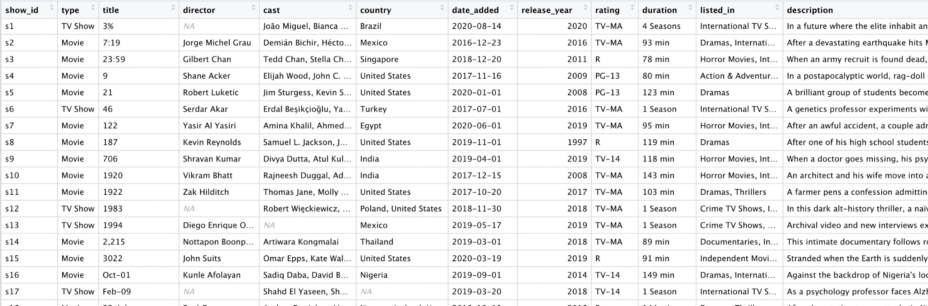
Dataset Description
https://www.kaggle.com/shivamb/netflix-shows
There are 7787 observations of 12 following variables describing the tv shows and movies.
Notes:
Movies and TV Shows listings on Netflix
https://www.kaggle.com/shivamb/netflix-shows
There are 7787 observations of 12 following variables describing the tv shows and movies.

Slide 3
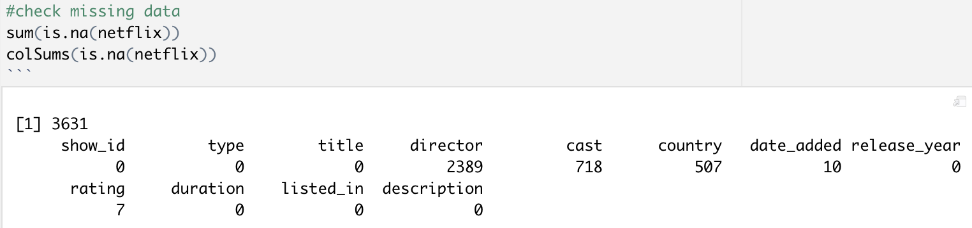
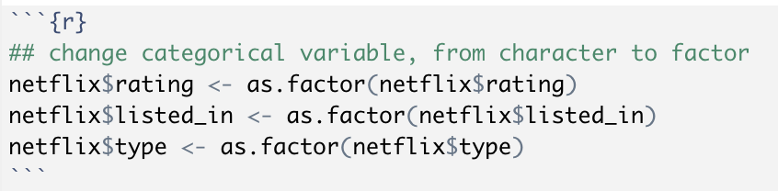
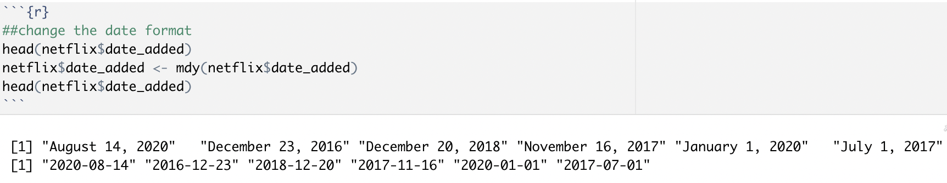
Data Preparation

Slide 4
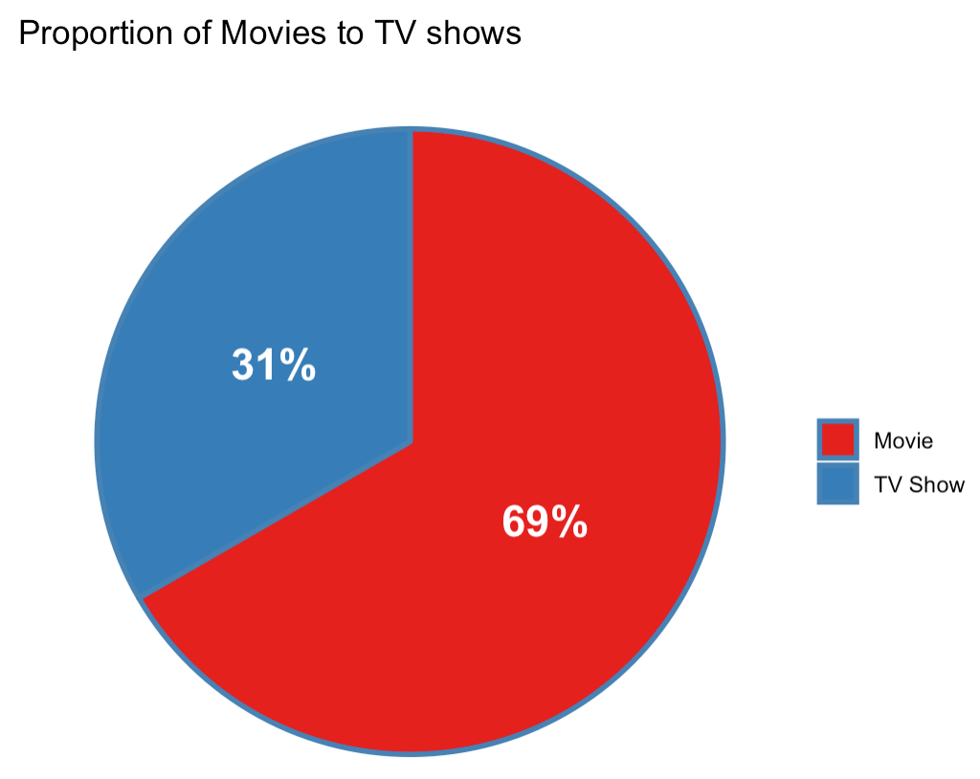
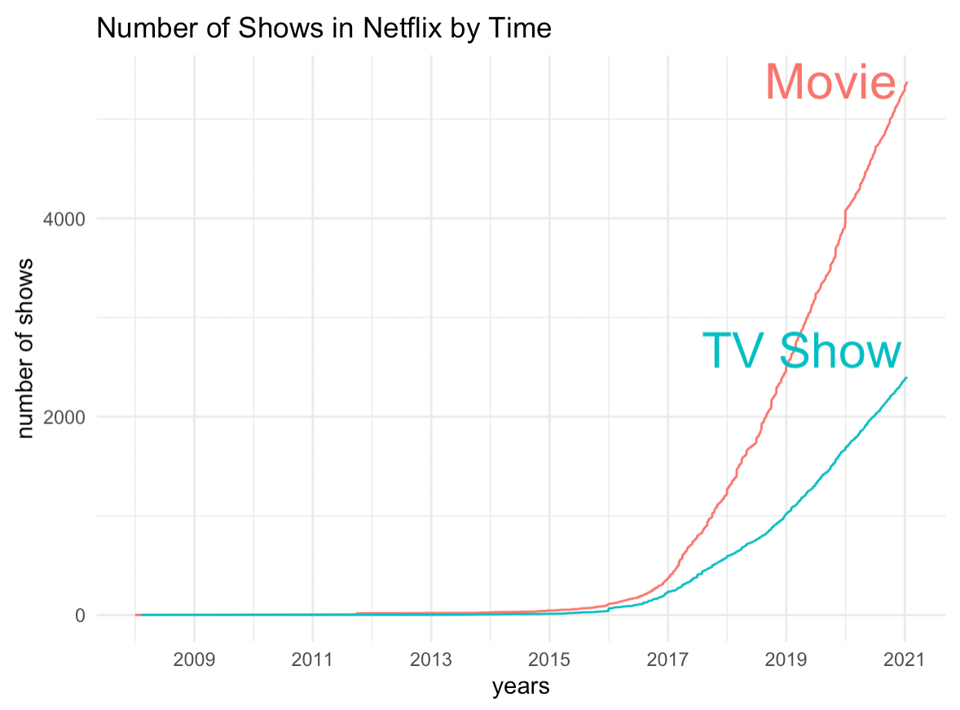
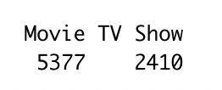
Visualize the Show Type & Trend of Shows Released Each Year
Notes:
Let’s take a simple look at the Visualize the Show Type, from the pie we can see that here are more than 2 times more Movies than TV Shows on Netflix.
then, let check for Trend of Shows Released Each Year, from the graph, we can see that the number of the shows started increasing by 2016 until now with a very steep trend.

Slide 5
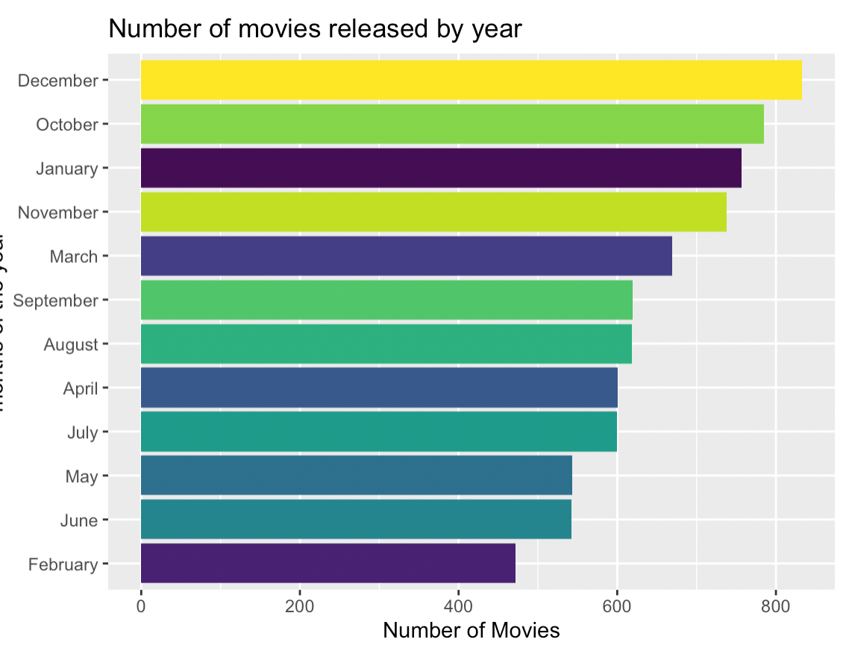
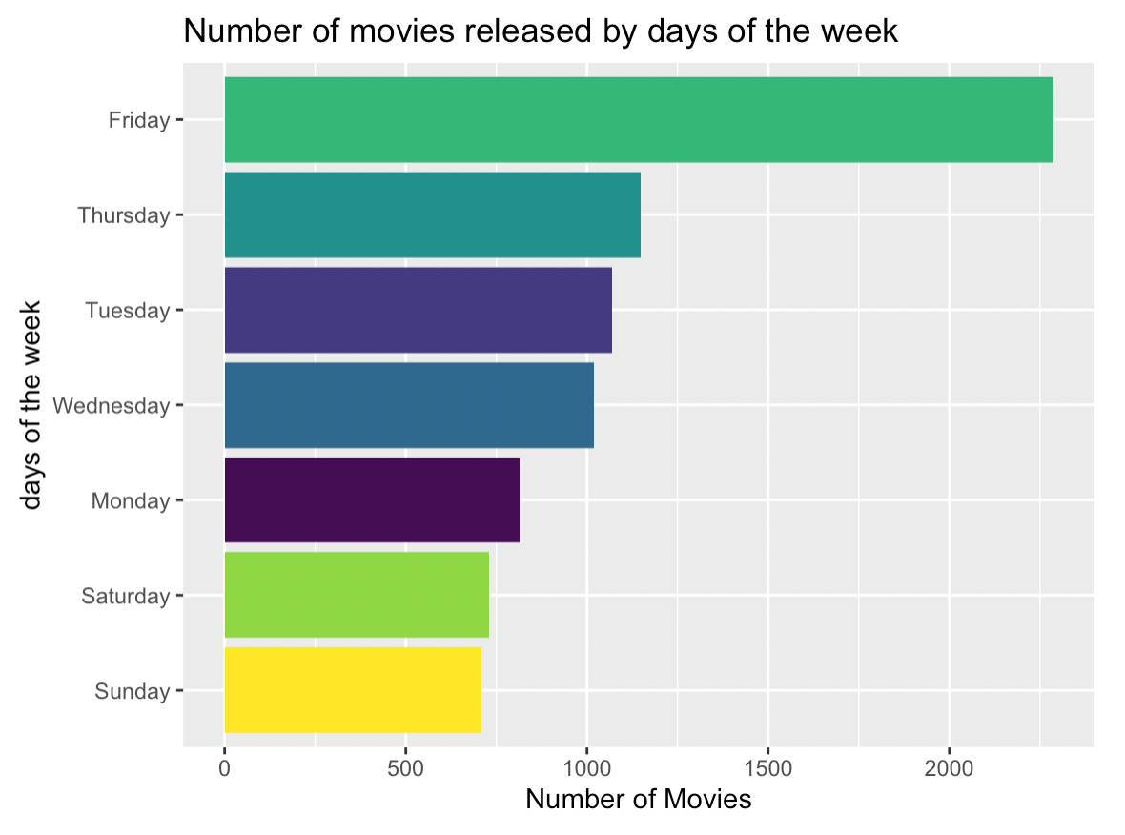
Movie Release Times
Notes:
we can see that most of movies are released during winter time, specially for Dec, maybe due to Christmas and New Year Break?
Also, we can see that most of movies released on Friday, maybe, because people can have time to watch them during weekend.

Slide 6
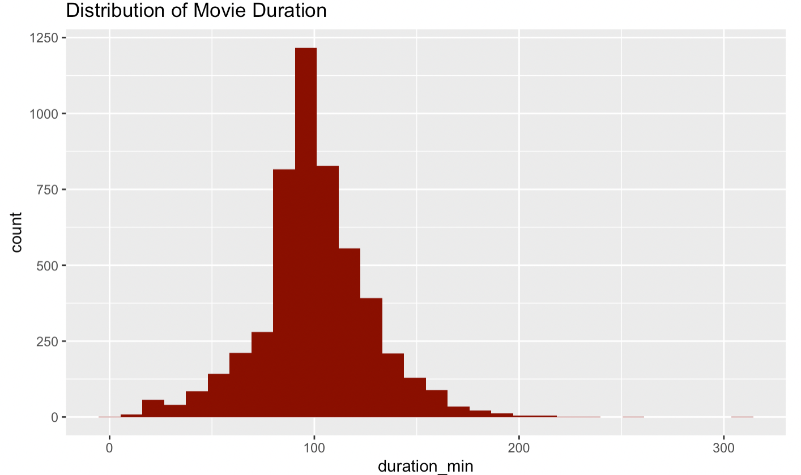
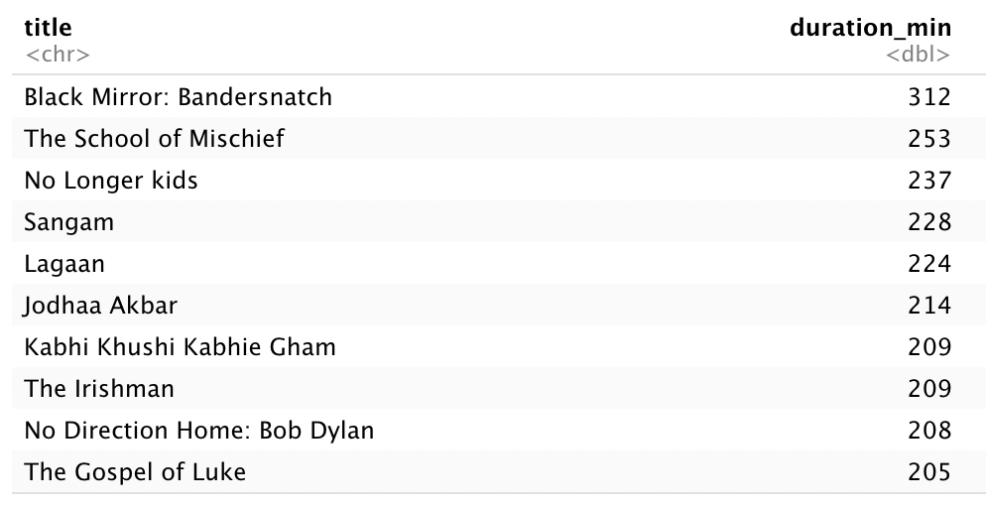
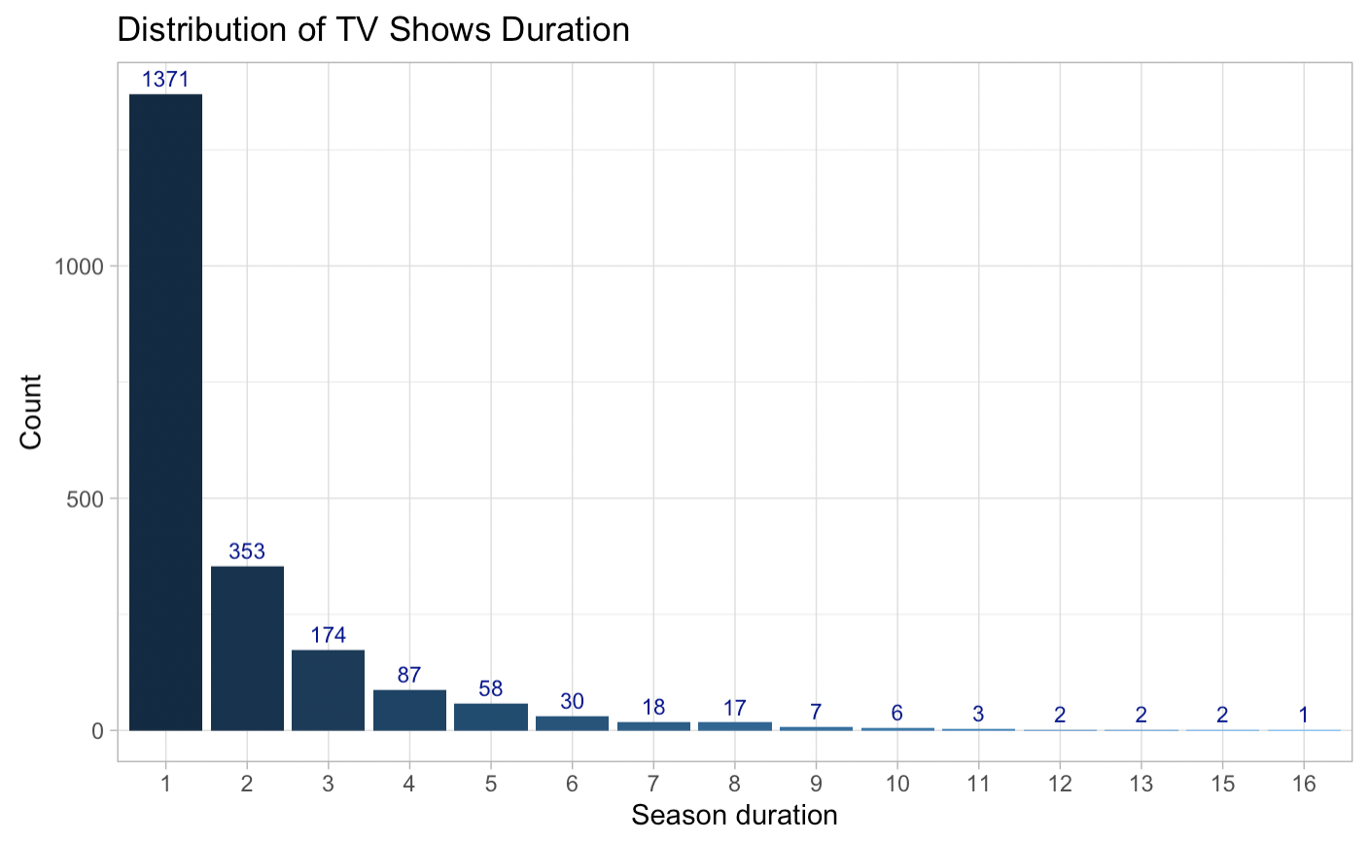
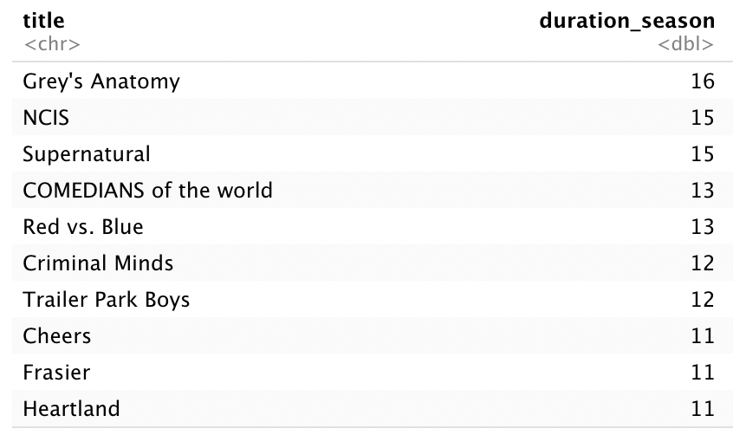
Durations for Movies and TV Shows
Which one is the longest?
Notes:
next, we can look at theh Duration for movies and TV shows,
for movie, most movie are around 100 minitutes, and the longest movie is Black Mirror???
However, I googled it, it’s a movie and only have 90mins.
for TV, most TV shows only 1 season, and we know that Grey’s anatomy has 16 seasons.

Slide 7
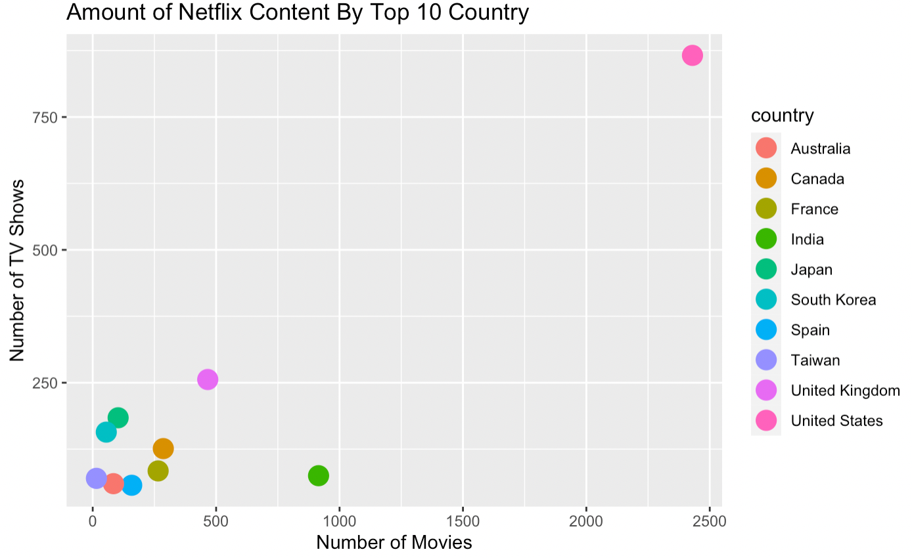
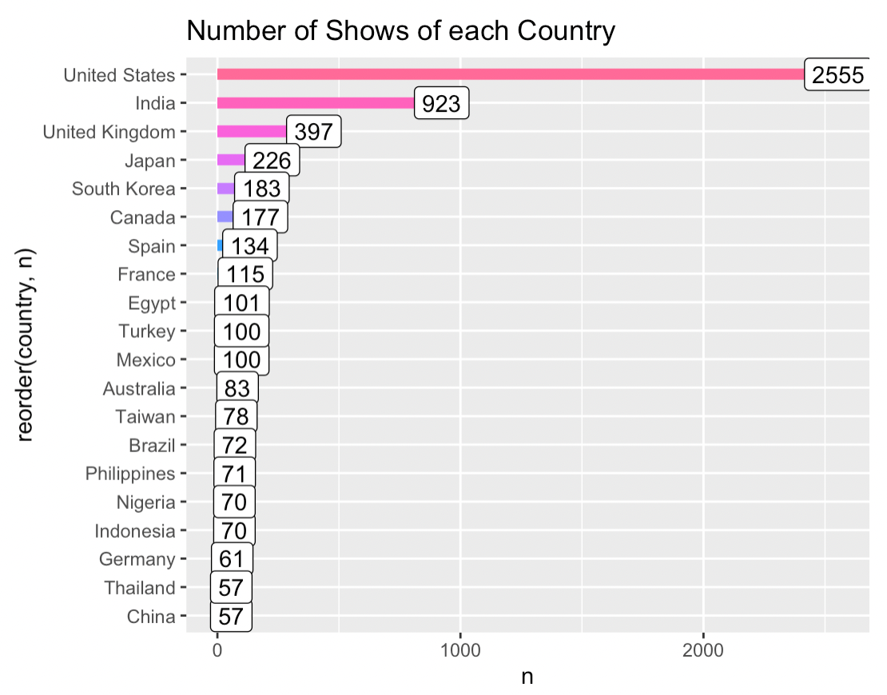
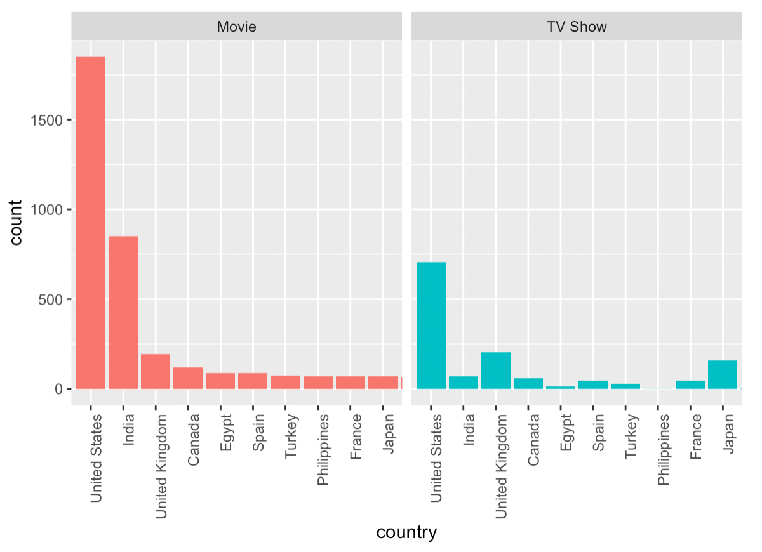
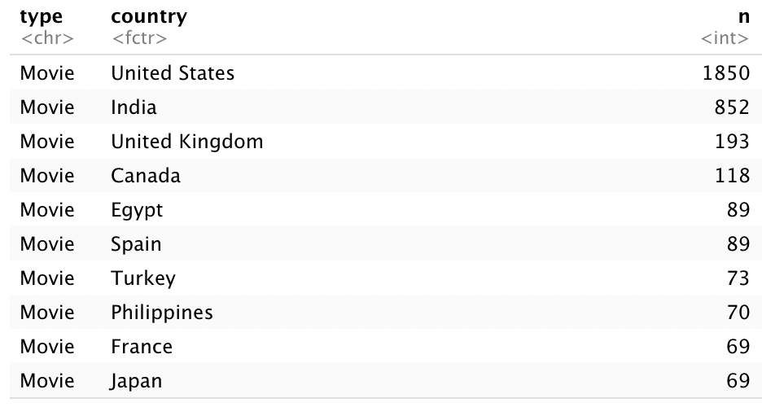
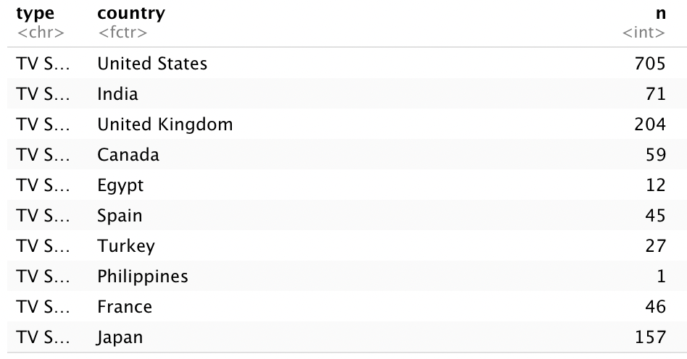
Which countries are producing most shows ?
Notes:
we can see that United States is a clear leader in the amount of content on Netflix., whcih is 2555. then India, with 923 shows.
Countries as Japan, UK have more TV Shows than Movies on Neflix.

Slide 8
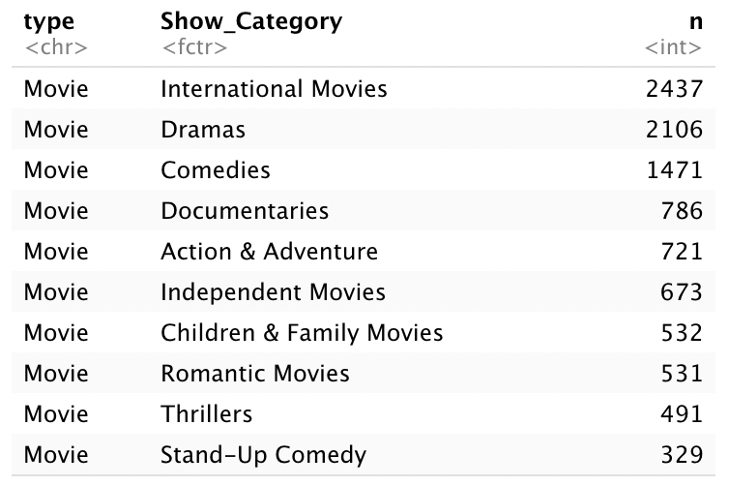
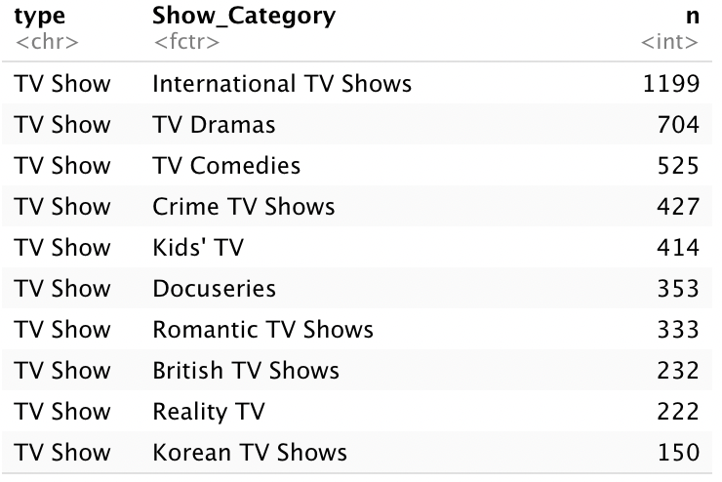
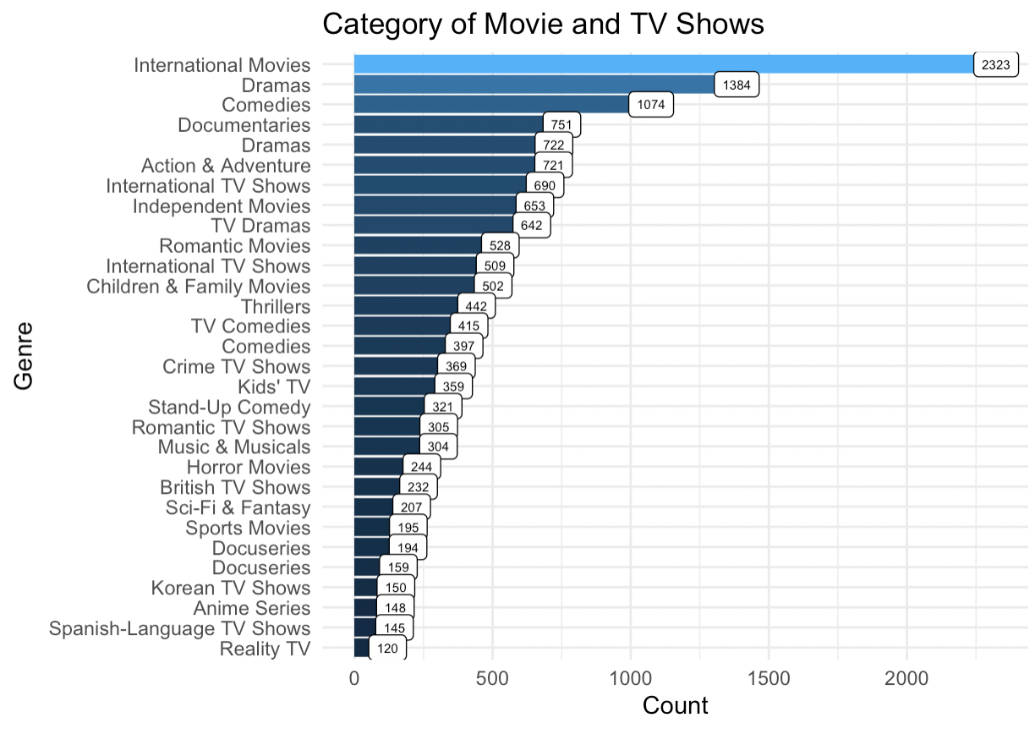
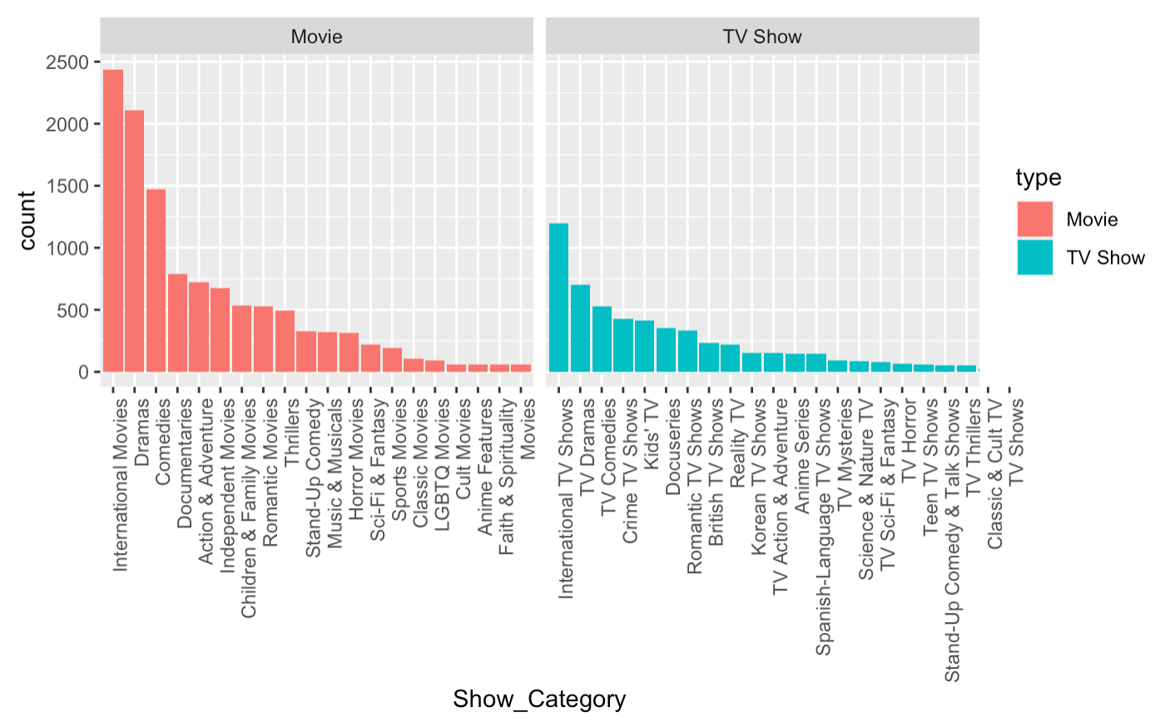
Show Categories
Notes:
It can be seen that International Movies / TV Shows are showing up as the dominant category in both Movies and TV shows, followed by Drama and Comedies.

Slide 9
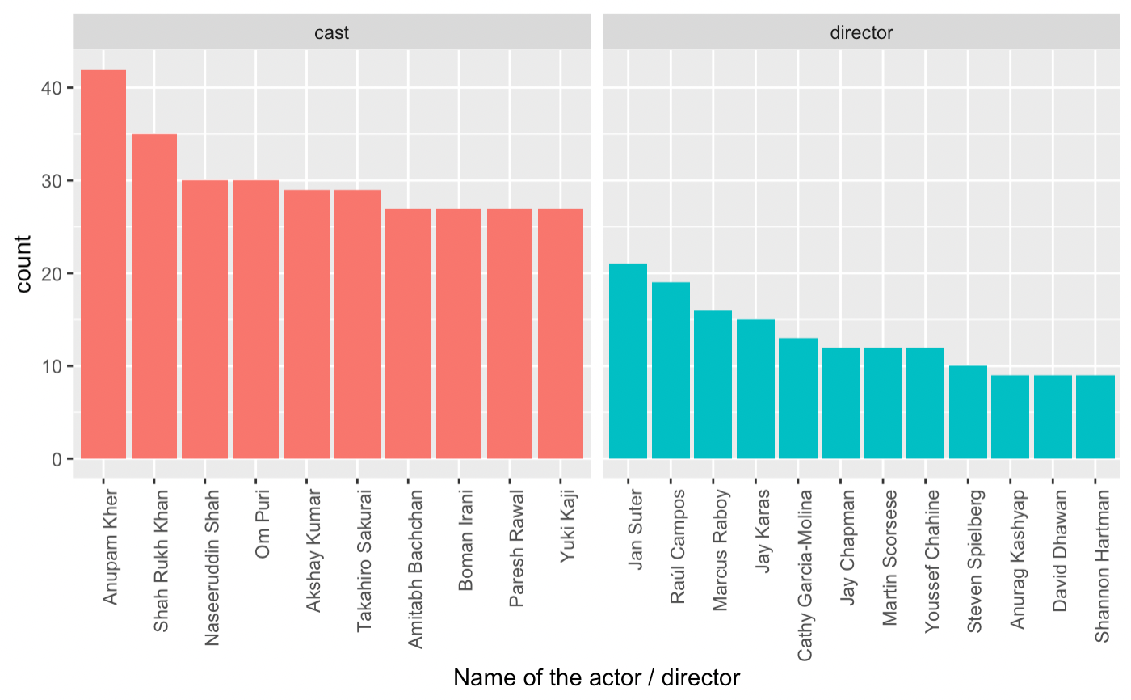
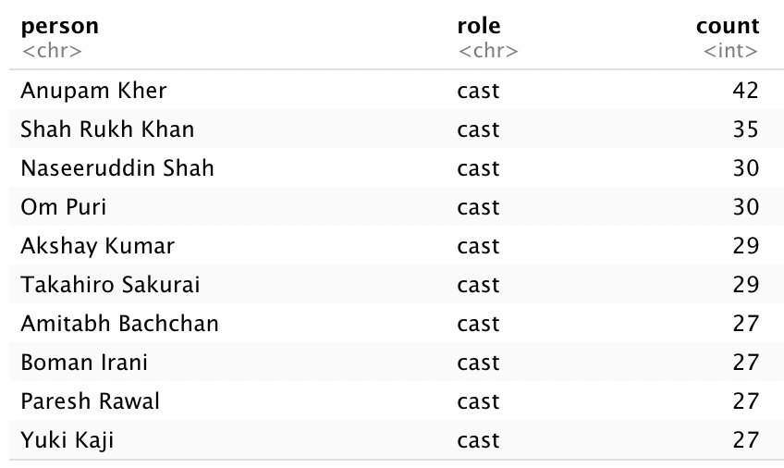
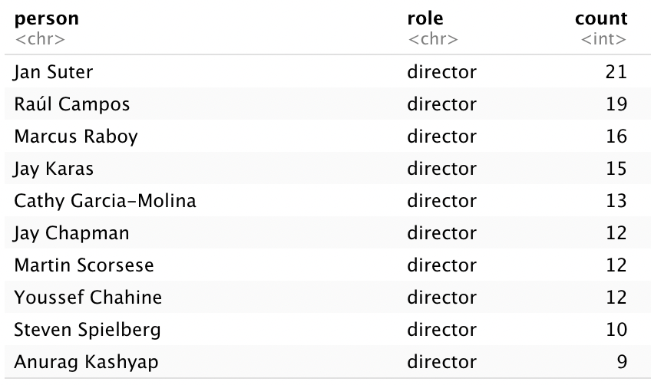
Exploring data related to actors/directors
Notes:
Let us take a look at the most prolific directors, and actors who are associated with most movies.

Slide 10
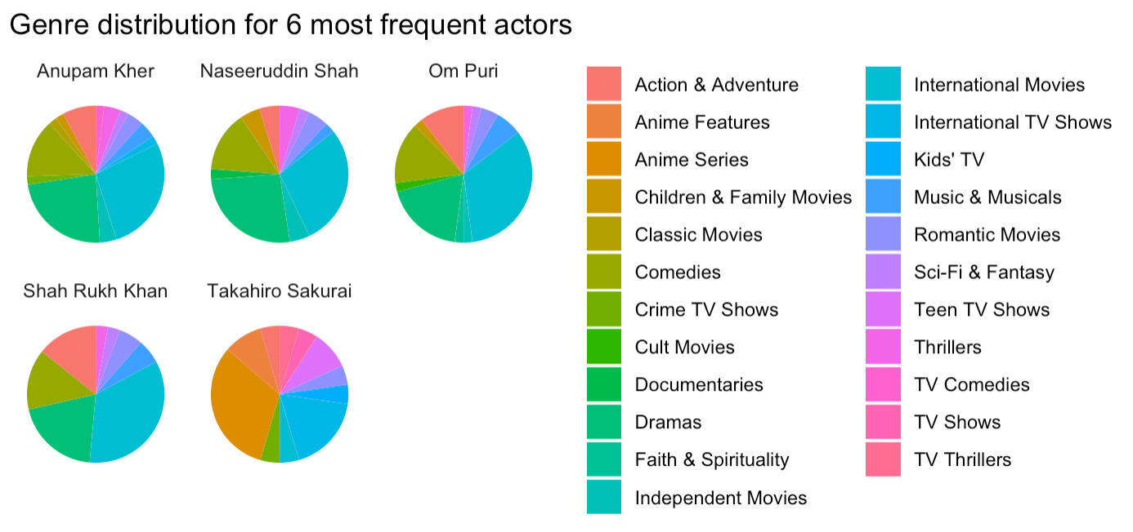
What Kind of Genres do Top Actors (by Frequency) Belong To?
Notes:
Takahiro has most genres belongs to Anime Series since he is a voice actor.

Slide 11
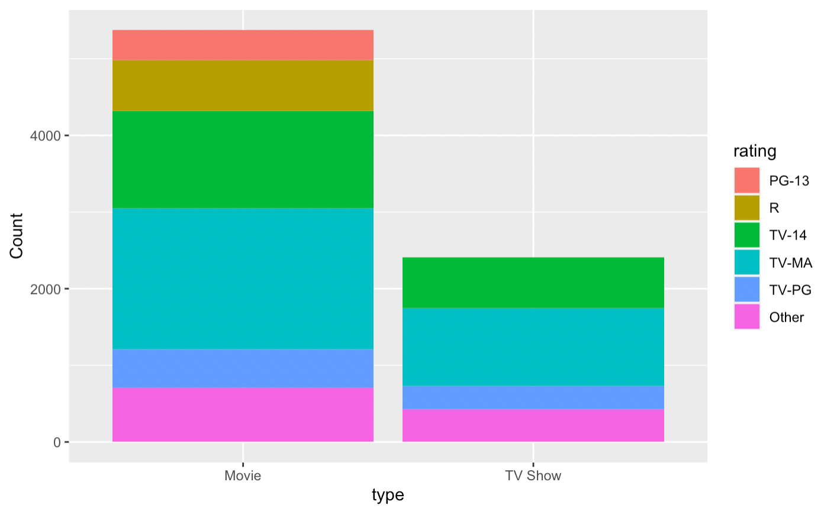
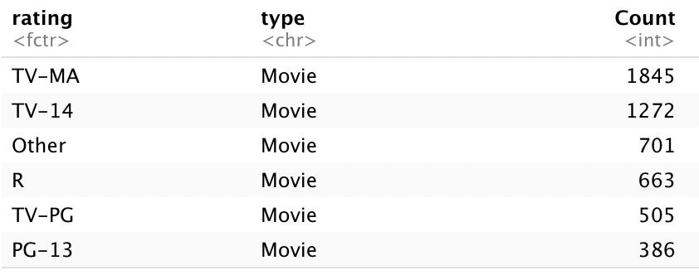
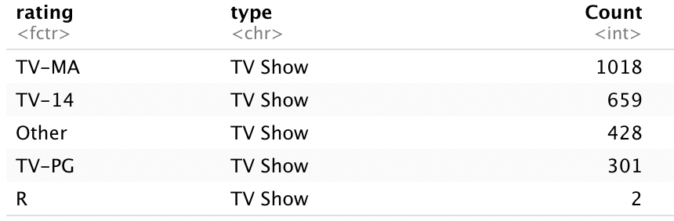
Rating by Type
PG-13: Parents Strongly Cautioned, Some Material May Be Inappropriate for Children Under 13.
R: Restricted, Children Under 17 Requires Accompanying Parent or Adult Guardian.
TV-14: shouldn’t be seen by anyone under 14.
TV-MA: shouldn’t be seen by anyone below the age of 17.
TV-PG: means that a show can be viewed by younger audiences but shouldn't be seen without their parents in the room.
Notes:
lets have some explanation…
the most rating is TV-MA which means should not be seen by anyone below 17, ans TV-14 which is not for people who under 14.

Slide 12
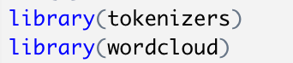
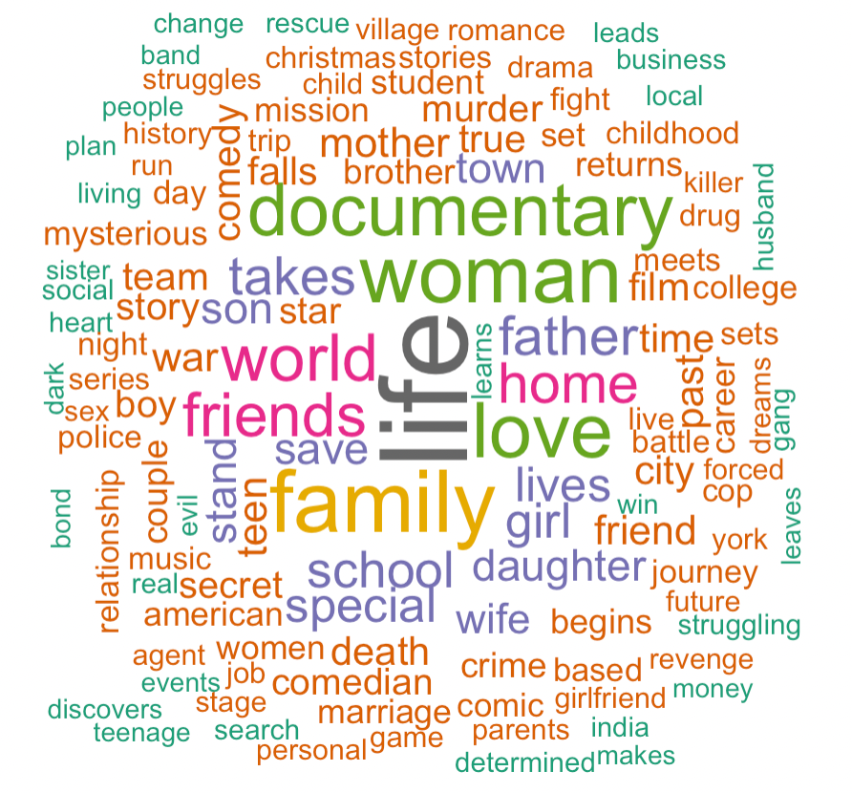
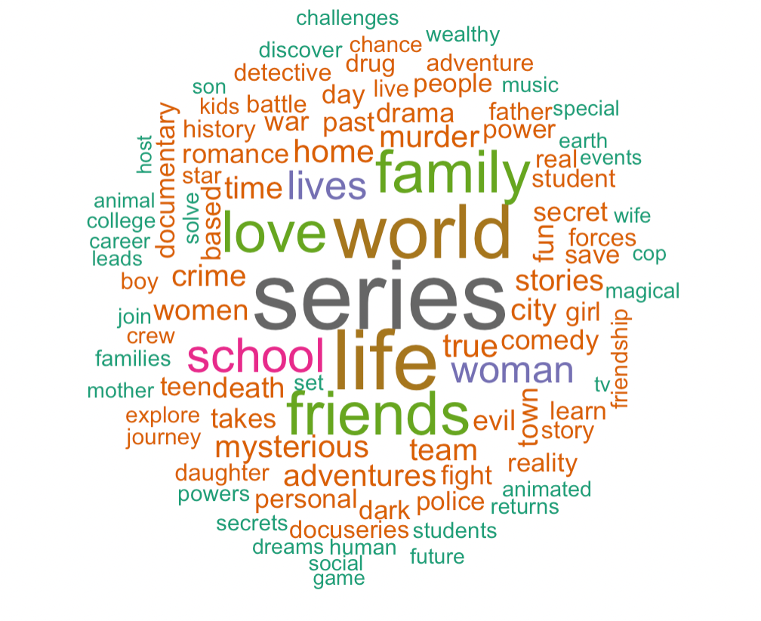
The Most Frequent Words Used in Titles:
Movies
TV Shows
Notes:
this is very intresting package when i was looking for what to do with tittles’ name, and lt also has great visulization.
Movie: # Life, Family, Women, Love, Friends, Home, World
TV: # World, Life, Love, Lives, Friends, Family, School are the most frequent words

Slide 13

Thank You!
Notes:
exploratory data analysis

